Slide 1
Introduction to machine learning
Introduction
R. Brooks

Slide 2



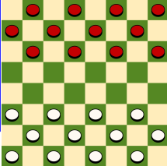


What is Machine Learning?
Tasks
Experience (Training Data)
Training
“A computer program is said to learn from experience E with respect to some
class of tasks T and performance measure P
if its performance at tasks in T, as measured by P, improves with experience E.”
(Tom Mitchell, 1997)
Learning algorithm
Prediction
Performance measure
Goal
Result

Slide 3

Why use Machine Learning?
The Challenge of Traditional Programming
Traditional coding struggles with tasks like handwriting recognition.
Understanding nuances (e.g., differentiating between '2' and '7') is complex.
Our brains excel at this, but how can we teach a computer?

Slide 4

Why use Machine Learning?
The Machine Learning Solution
Learning from Examples: We feed the machine examples rather than explicit instructions.
Algorithm-Generated Programs: Machine learning algorithms create flexible programs based on data.
Adaptability: These programs generalize to recognize new examples beyond the training set.

Slide 5
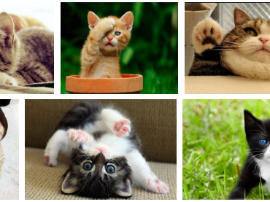
Solving Complex Problems with Machine Learning
Traditional Approach: Manually encode rules to solve problems.
Challenge:
Difficult to define explicit rules for complex tasks (e.g., recognizing cats in images).
Machine Learning Approach:
Learn from Data: Develop a solution by learning from examples.
Trial and Error: Refine the approach by experimenting and learning from mistakes.
Outcome: The system creates its own set of rules from the learning process.

Slide 6
Example: Titanic

Slide 7
Machine learning methodology – simplistic view
Data
Machine learning algorithm
Training data
Trained
model
Features
Labels
Labels
New data
Predicted
label
Only features!

Slide 8
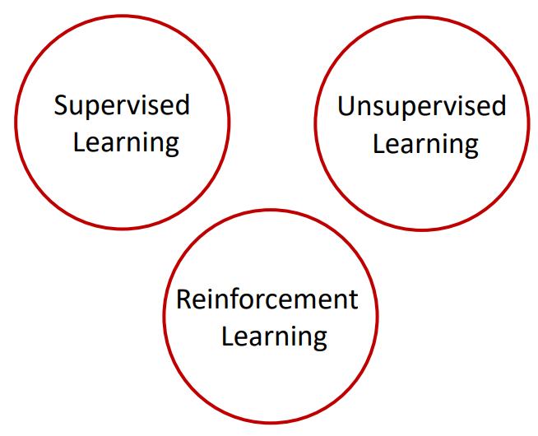
Taxonomy of Machine Learning (A Simplistic View Based on Tasks)

Slide 9
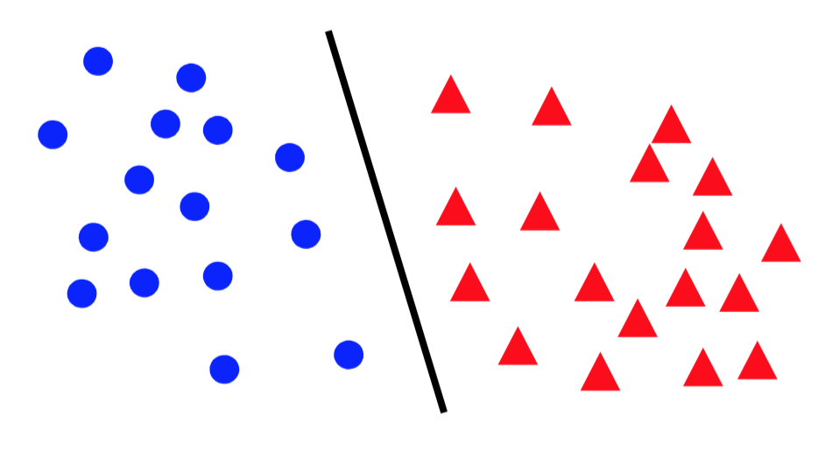
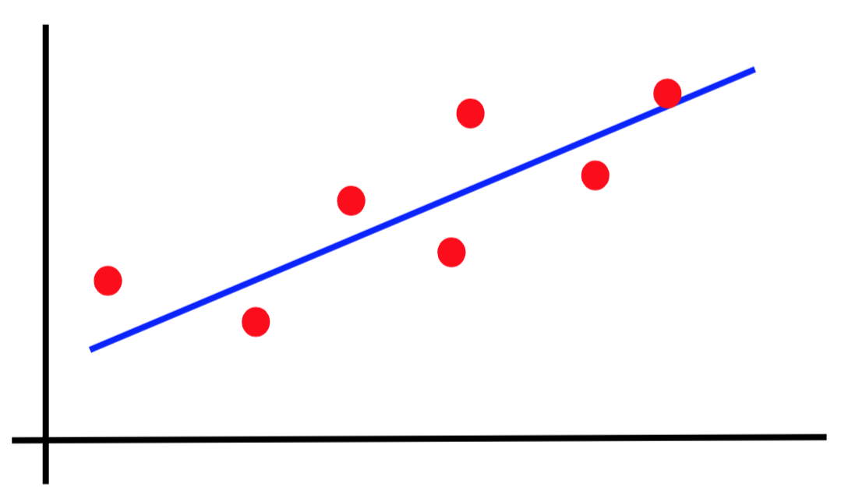
Canonical forms of supervised learning problems
Classification
Regression

Slide 10
Understanding Variables in Machine Learning
Variables
Predictors
Covariates
Regressors
Dimensions
Attributes
Features
Inputs
Independent Variables...
X
Response Variable
Outcome
Target
Class
Label
Output
Dependent Variable
Y

Slide 11
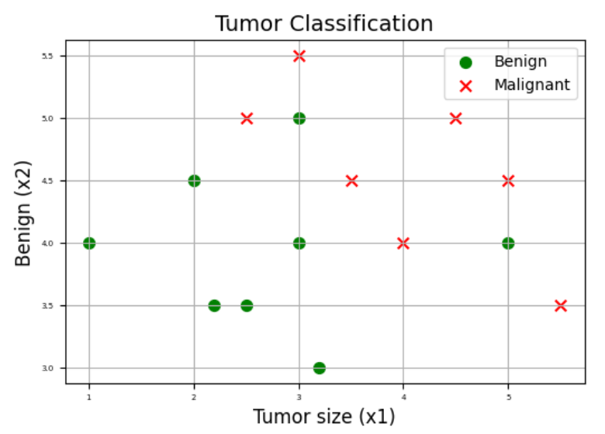
Supervised

Slide 12
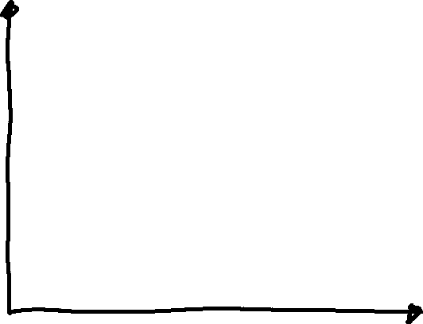


Unsupervised - Clustering

Slide 13
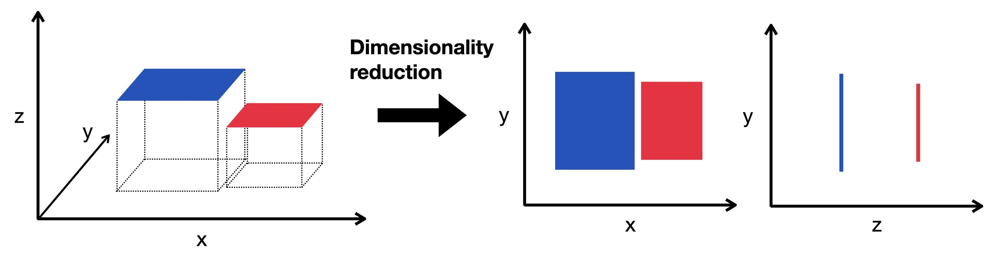
Unsupervised – Dimensionality Reduction

Slide 14
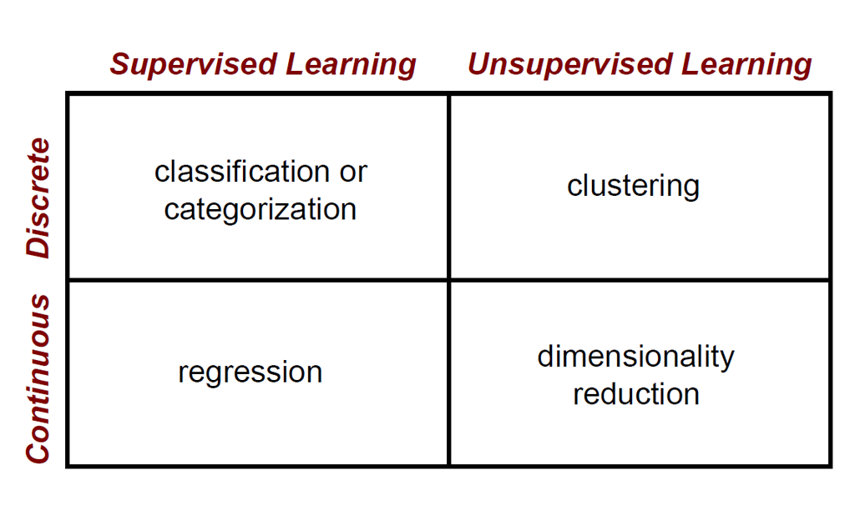
Machine Learning Problems

Slide 15
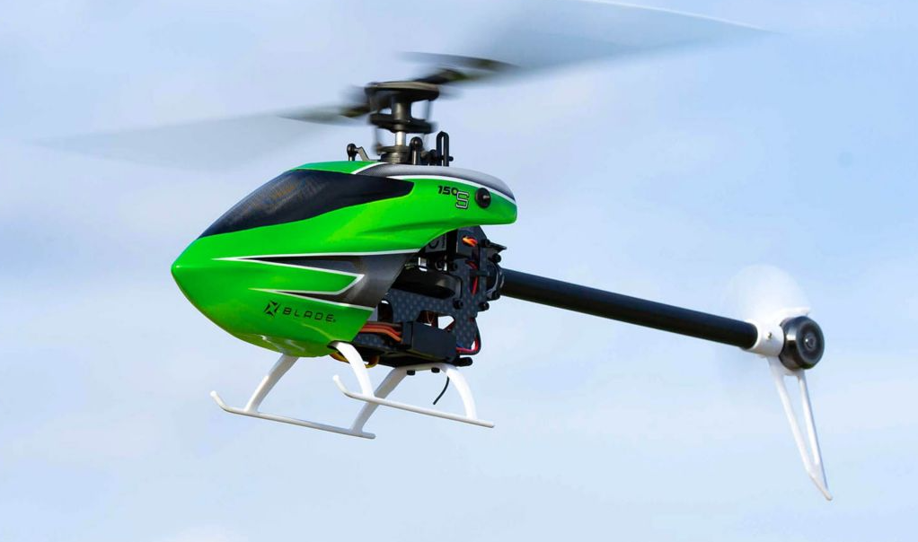
Reinforcement Learning

Slide 16
Test accuracy
Tune hyperparameters
Data
Machine learning algorithm
Training data
Trained
model
Features
Labels
Labels
Testing data
New data
Predicted
label
Only features!

Slide 17

Who?
Jakob Mørup Wang: jakm@via.dk

Slide 18
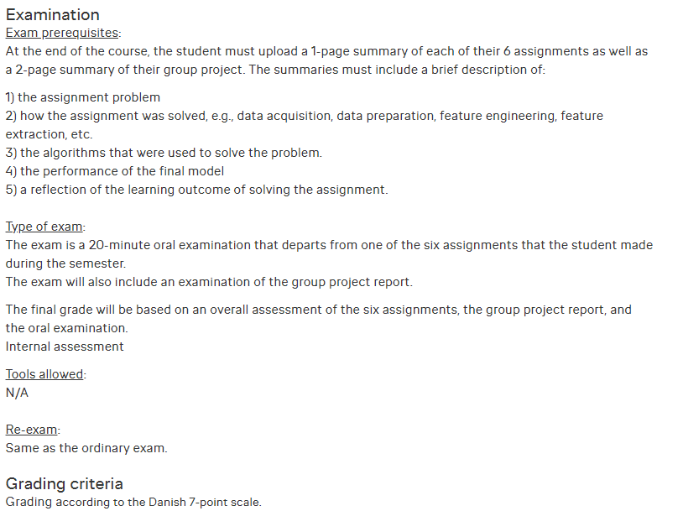
Evaluation

Slide 19
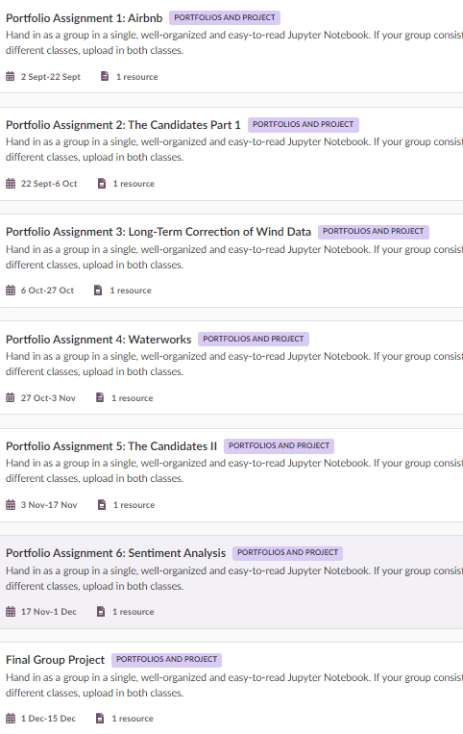
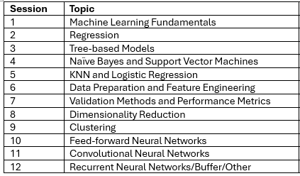
The Overview (changes may occur!)

Slide 20
















The Machine Learning Pipeline
Look at the big picture.
Get the data.
Discover and visualize the data to gain insights.
Prepare the data for Machine Learning algorithms.
Select a model and train it.
Fine-tune your model.
Present your solution
Launch, monitor, and maintain your system.
Test data
Model requirements
Training data
Metrics
Trained model
Raw data
Predictions
Requirements
Data
Data
Predictive
Evaluation
Deployment
Analysis
Acquisition
Preparation
Modelling
Icons made by Smashicons from www.flaticon.com
Business metrics
Acceptance criteria
Data protection
Ethics
Interpretability requirements
Exploration
Quality assessment
Cleansing
Labeling
Imputation
Feature engineering
Algorithm selection
Feature selection
Model training
Hyperparameter tuning
Model selection
Evaluation Metrics
Inspection
Interpretation
Manual evaluation
Model compression
Model versioning
Process integration
Monitoring
Online learning
Data collection
ETL
Data integration
De-identification
Feedback
Roles
Data Scientist
Domain Expert
(Data) Engineer

